Slide 1
Leadership Updates
3/11/2020

Slide 2
Objectives
Current PACIO Project status
Discuss alignment with existing FHIR Projects
Connectathon preparation

Slide 3

Current Project Status:
Identifying the Data Model
Requirements
Search for existing FHIR IG’s for those data models
Identify gaps in the data models
Decision to adapt or develop new FHIR IG
FHIR IG Development
Determine which fields will be used
Determine which extensions need to be added
Determine if cardinalities need to be changed
Specify profiles and extensions
Specify Queries
Testing
Reference Implementation Development
Build data set
Build test set
Build initial RI
Stand up FHIR server and database server
Load all implementation guides, StructureDefinition, ValueSet & CodeSystem to FHIR server
Develop ways that clients will need to efficiently query the data
Testing

Slide 4
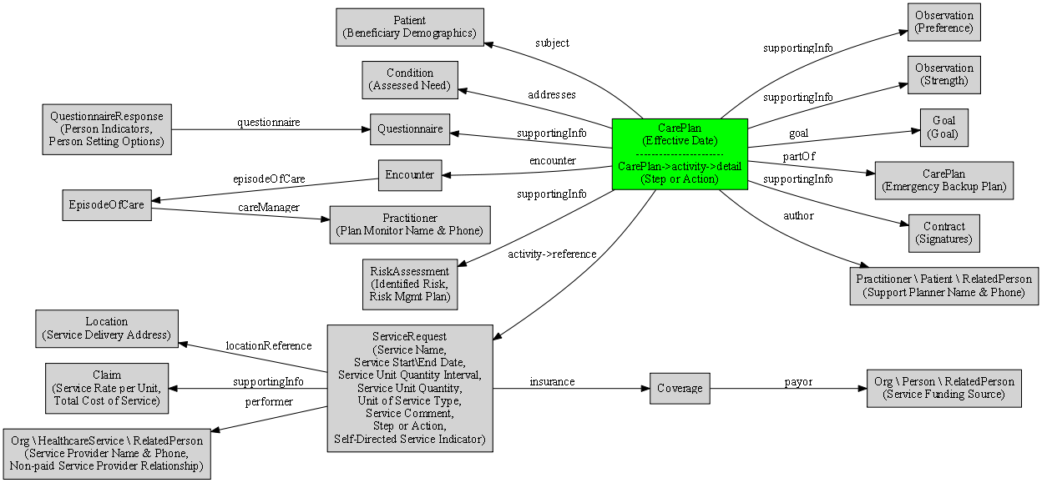
Aligning with existing FHIR Projects
electronic Long-Term Services and Supports (eLTSS) Implementation Guide (IG)
IG Goals:
Identify components or data elements needed for the electronic creation and interoperable exchange of person-centered service plans by health care and HCBS providers, payers and the individuals they serve and
Field test these data elements within participating organizations’ electronic systems.
Based on FHIR R4, currently scoped to data commonly found on LTSS service plans.
Link to Implementation Guide: http://hl7.org/fhir/us/eltss/2019May/

Slide 5
Aligning with existing FHIR Projects
eLTSS Reference Implementation
Altarum Institute is developing the eLTSS reference implementation
https://github.com/onc-healthit/eLTSS-reference-implementation
Working with the State of Michigan
Participated in the Care Planning and Management Track at the September 2019 Connectathon in Atlanta, GA
https://confluence.hl7.org/display/FHIR/2019-09+Care+Planning+and+Management+Track
Connectathon use case: https://confluence.hl7.org/display/FHIR/2019-09+Care+Planning+and+Management+Track?preview=/55936474/66914314/Use%20Case%20eLTSS%20FHIR%20Beneficiary%20Care%20Coordinator%2020190903.docx
Connectathon use case was based on Chronic Kidney Disease Care Management
Altarum Institute is reviewing the PACIO Project use case and developing recommendations on integration
Held a discussion with Altarum and eLTSS on merging use cases
EMI Advisors / State of Missouri
EMI Advisors is helping the eLTSS project to test the implementation guide with the State of Missouri
Including FASI data elements

Slide 6
PACIO – eLTSS Use Case Comparison
Use Case Components | PACIO – Betsy Smith | eLTSS – Betsy Johnson
CarePlan | n/a | Exercise / join a fitness club Snow Emergencies: A shelf stable blizzard meal is delivered to Meals On Wheels clients in early winter. It is to be eaten in the unlikely event of cancellation. Blizzard meals are donated by the Sheboygan Service Club.
Claim | n/a | Cost of service
Condition | Hypertension, hyperlipidemia, stage 3 chronic kidney disease, ischemic heart disease, depression, cataracts, osteoarthritis, type II diabetes | Lack of access to transportation, difficulty bathing self, difficulty performing dressing activity

Slide 7
PACIO – eLTSS Use Case Comparison (cont’d)
Use Case Components | PACIO – Betsy Smith | eLTSS – Betsy Johnson
Contract | n/a | Service provider signatures
Coverage | n/a | Links to the eLTSS Service Funding Source
Encounter | Sample encounter for Betsy Smith | n/a
EpisodeOfCare | n/a | Connects Beneficiary with Care Manager
Goal | Return to her baseline functional status (independent with a cane) and return home once she can safely do so. | Lose weight, dance at daughter's wedding
Location | Texas, Maryland | 2222 Peachtree Street, Atlanta GA, 30318 7247 Breen St., Springfield IL, 62707

Slide 8
PACIO – eLTSS Use Case Comparison (cont’d)
Use Case Components | PACIO – Betsy Smith | eLTSS – Betsy Johnson
Medication | Lisinopril 40mg twice a day • Glargine 24 units SQ nightly • Atorvastatin 40mg nightly • Insulin 3 units with each meal • Calcium 500mg daily • Sertraline 25mg nightly • Vitamin D 800IU daily • Tylenol 650mg every 6 hours or as needed • Furosemide 20mg daily • Ferrous Sulfate 325mg three times a day prior to meals | n/a
MedicationRequest | Connects Medication with Patient | n/a
Observation | Bundled Functioal Status, Functional Status, Bundled Cognitive Status, Cognitive Status | Accessing the ICWP Waiver for her current service needs, and would like to remain on ICWP and continue with her current services Able to manage her bills. Has strong family support

Slide 9
PACIO – eLTSS Use Case Comparison (cont’d)
Use Case Components | PACIO – Betsy Smith | eLTSS – Betsy Johnson
Patient | Betsy Smith, 69-year old white female widow | Betsy Johnson, 63-year old
Practitioner | PCP • Cardiologist Endocrinologist • Nephrologist • Psychiatrist • Ophthalmologist • Retail Pharmacy • Lab Services | Service Provider, Care Manager, Planner, Provider
Questionnaire | n/a | Service Questionnaire
QuestionnaireResponse | n/a | Service QuestionnaireResponse
RelatedPerson | n/a | Jane Daughter, Guardian: William Barrister
RiskAssessment | n/a | Risk for falls
ServiceRequest | n/a | Personal care services, per 15 minutes, non-emergency transportation - encounter/trip, house cleaning

Slide 10
Proposed Architecture for HL7 Connectathon
Mobile/Web Portal
Functional/Cognitive, Care Plan
Functional/Cognitive, Care Plan
Care Setting A EHR
Functional/Cognitive, Care Plan
Care Setting B EHR
Functional/Cognitive, Care Plan
Assessments
Assessments
CMS Pseudo DEL

Slide 11

Preparing for the May HL7 Connectathon
Clinical assistance needed for:
Building a use case for the connectathon that aligns PACIO Project, eLTSS, Altarum and EMI advisors work
Generating sample data for the connectathon
Technical assistance needed for:
Writing / reviewing the Implementation Guide
Developing the Reference Implementation
Developing vendor implementations
Need three independent IG implementations for ballot approval
Testing
ONC Inferno (servers), AEGIS Touchstone (servers, clients)

Slide 12

Preparing for May HL7 Connectathon
Task | Volunteer(s)
Participant Recruitment
Implementation Guide Development
Generate Sample Data
Server Reference Implementation
Client Reference Implementation
Test Scripts
Hosting Reference Server
Hosting Reference Client
Second Implementation (Server, Client)
Third Implementation (Server, Client)
Connectathon Track Lead

Slide 13
HL7 May Connectathon Timeline
3 April 2020
FHIR Connectathon Track Proposals
16-17 May 2020
HL7 Connectathon
1 May 2020
Reference Implementation Functionally Complete
10 April 2020
Implementation Guide Draft Complete
https://confluence.hl7.org/display/HL7/HL7+Calendars
https://confluence.hl7.org/display/FHIR/2020-05+Connectathon+24

Slide 14
Balloting Timeline
22 May 2020
FHIR Resource Proposals Due
16 August – 14 September 2020
Ballot Open for Voting
5 July 2020
Notice of Intent to Ballot
FHIR Implementation Guides must be substantially complete
21 June 2020
FHIR Implementation Guide Proposals Due
14 Sept – 28 Sept 2020
Oct – Dec 2020 (estimate)
January 2021 (estimate)
Ballot Triaging
Prioritizing, categorizing, grouping
Ballot Reconciliation
Address all comments and develop responses
STU1 Ballot Approval
Publishing STU1 IG
February 2021 (estimate)
Gain approval from sponsoring work groups
Gain approval of FHIR Management Group and Technical Standards Committee
https://confluence.hl7.org/display/HL7/HL7+Calendars

